Slide 2
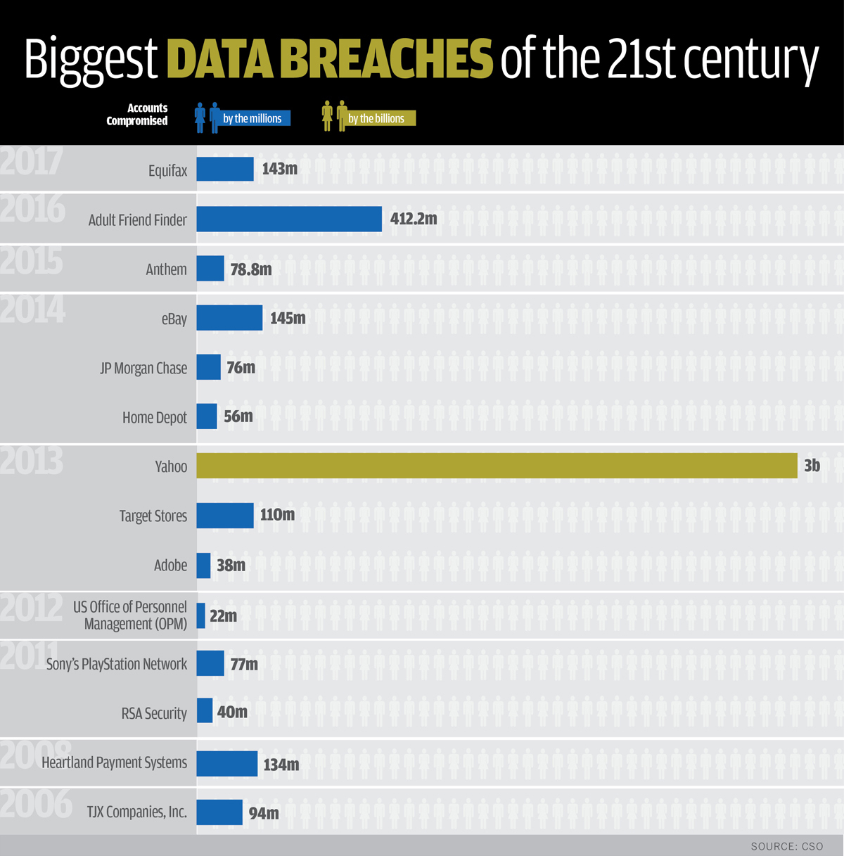

Slide 3
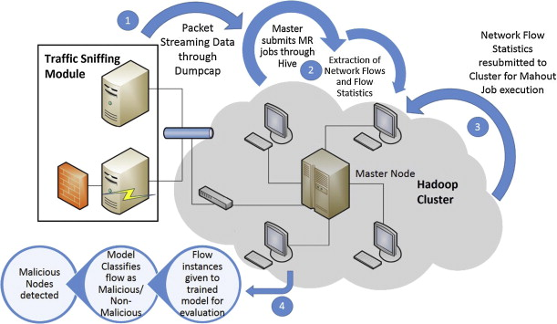

Slide 4
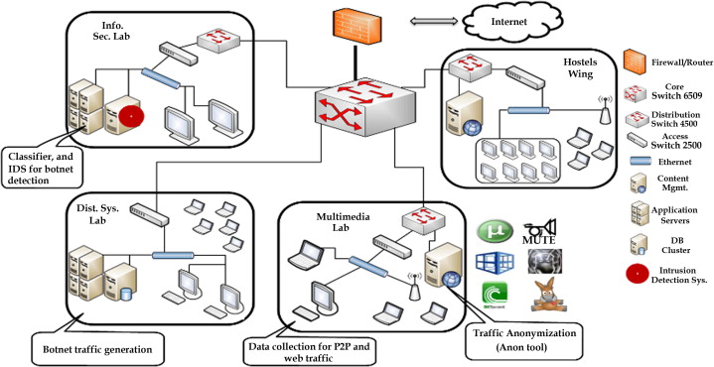

Slide 5
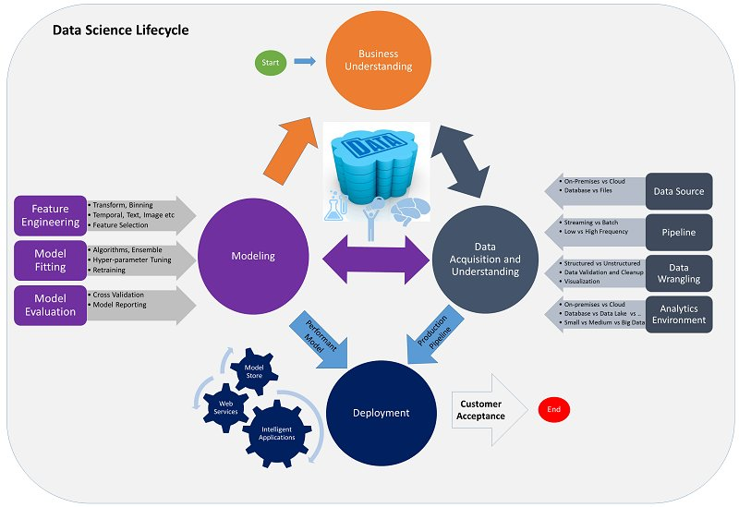

Slide 9
Data normalization
Raw Data Storage

Slide 10
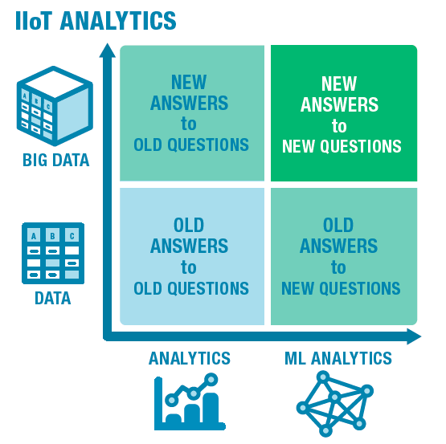

Slide 11
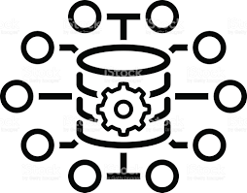
Better correlation with additional context – Improved Threat Analysis
Predictive ,Intelligent actionable Threat Analysis
Big Data
Standard Security Monitoring and threat Analysis
New pattern based perspective to old Log data – Predictive threat patterns
Log Data
Analytics
ML based Analytics

Slide 12
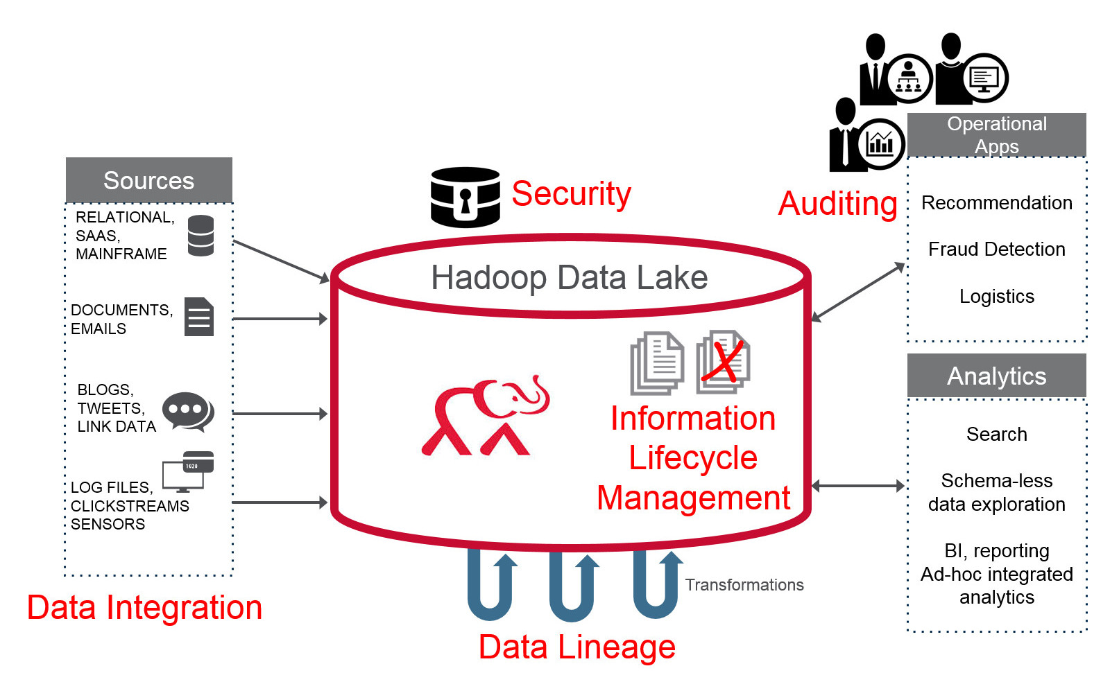

Slide 13
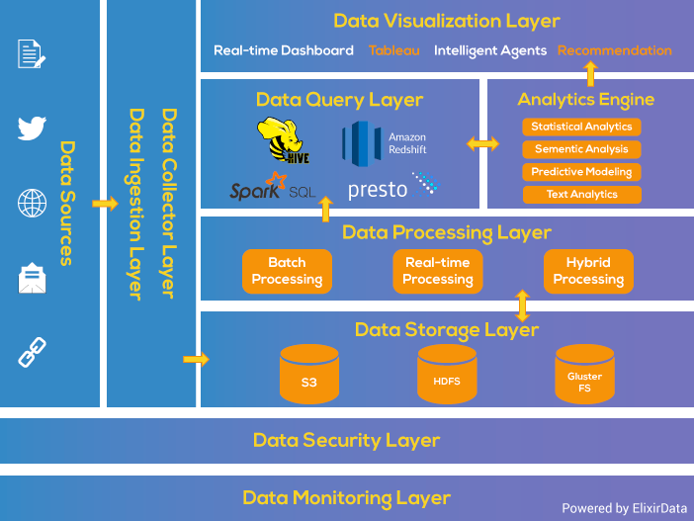

Slide 14
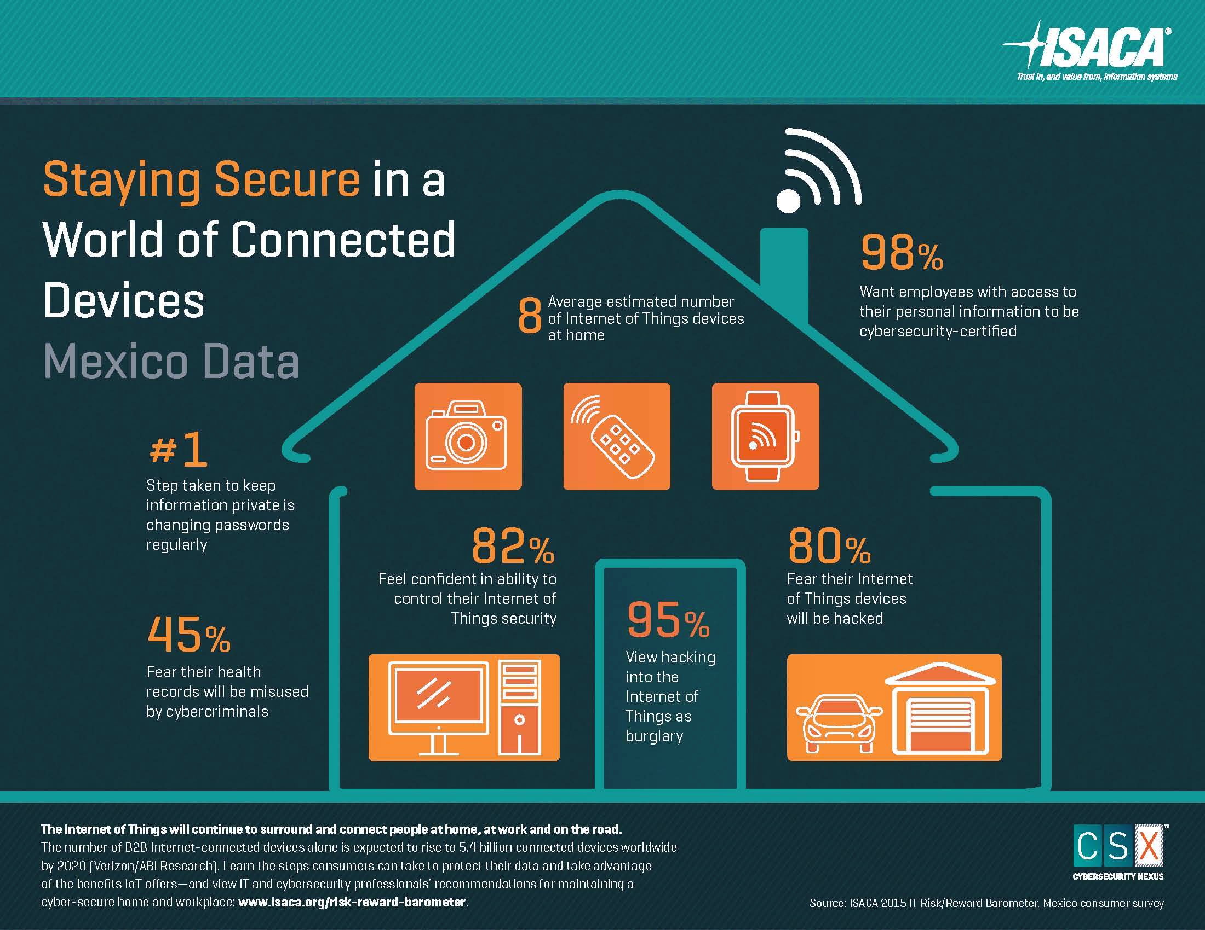

Slide 15
